Slide 1
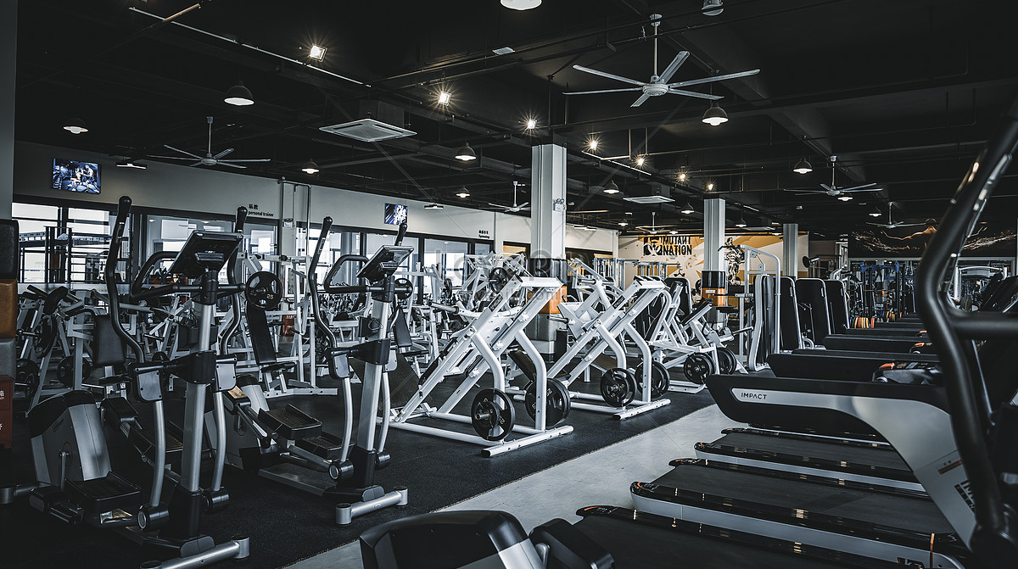
GYM MANAGEMENT SYSTEM
Group Members
Khizer Naeem.
Rahim Ahmed Khan.
Raheel Ali.

Slide 2

Introduction
The Gym Management System is designed to streamline gym operations, offering efficient management of members, trainers, classes, payments, and equipment. Key features include:
1. Member and Trainer Management: Keep detailed records and schedules.
2. Class Scheduling and Attendance Tracking: Organize classes and track member attendance.
3. Payment Processing: Manage membership payments and financial transactions.
4. Equipment Maintenance: Monitor and maintain gym equipment.
5. Diet and Workout Plans: Create personalized plans for members.
6. Event Management: Plan and manage gym events.
7. Feedback and Complaints: Collect member feedback for continuous improvement.
This system enhances efficiency, member satisfaction, and resource optimization, allowing gyms to focus on promoting a healthy and active lifestyle.
GYM MANAGEMENT SYSTEM

Slide 3
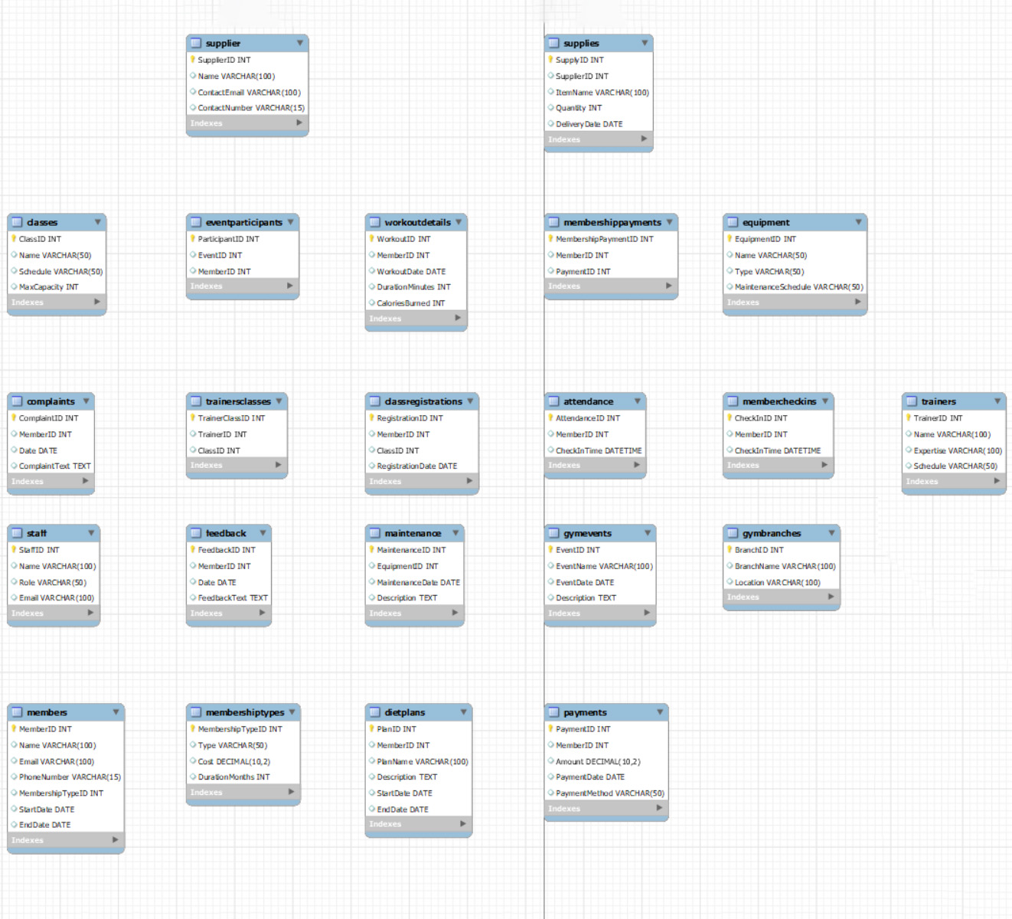
ER Model

